Slide 1
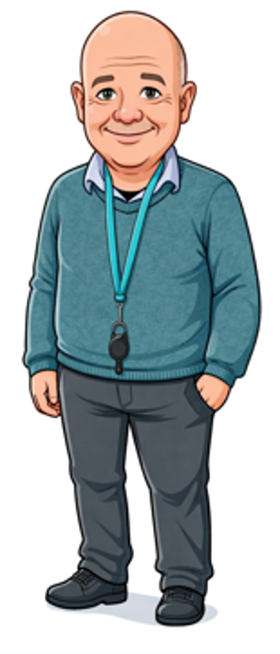
14) ESCCCP24 2025-2026 16 June 2026
Andrew Patterson covering for Gözde.

Slide 2
Check-in
Tue 16 June 2026

Slide 3
Work from 11 June 2026
Using LEVEL 2 PROGRESS TEST 2 – Term 3 2026 ANSWER KEY.docx, we
looked at some of the more common issues from the progress test.
Using Plus FCE Opinion Piece.pptx, and
06)PlusFCE Discursive Essay_pp74-78.pdf, we
learnt to write an essay.
Homework
Ex 2a see next slide.
06)PlusFCE Discursive Essay_pp74-78.pdf

Slide 5
Integrated Skills
17:45-20:45

Slide 6
16_tenses_lesson.pptx
B2_16_tenses_worksheet.docx
Plus FCE Opinion Piece.pptx

Slide 7
Check-out
Tue 16 June 2026

Slide 8
Using 16_tenses_lesson.pptx and B2_16_tenses_worksheet.docx, we
Learnt the 16 tenses in English plus the imperative, and
Practiced making the passive
Using Plus FCE Opinion Piece.pptx and 06)PlusFCE Discursive Essay_pp74-78.pdf, we
Started p. 78 Ex 3.
Homework
06)PlusFCE Discursive Essay_pp74-78.pdf
p. 78 Ex 3. See next 3 slides.

